Slide 1
Heterogenous Swarming and Formations of BOLT and RVR

Slide 2
Problem Statement
Aim:
To achieve emergent formations within heterogeneous swarms of RVR and BOLT robots
Significance:
Research into formations of heterogeneous swarms lags that of homogeneous swarms
Heterogeneous swarms have shown significant promise in real – world applications
Notes:
Swarm robotics involves multiple robots working together to achieve a common goal, inspired by biological systems like flocks of birds or schools of fish.
Heterogeneous swarms consist of different types of robots, enhancing flexibility and functionality compared to homogeneous swarms, which use identical robots.

Slide 3
Literature Review
Boid Model and Swarm Formations
Rules based between agents
Applications of Heterogeneous Swarms
Search and rescue
Environmental monitoring
Autonomous exploration
Benefits of Heterogeneous Swarms
Scalable
Robust
Flexible
Capable
Models natural swarm intelligence
Notes:
Overview of Existing Research:
The Boid Model and Swarm Formations: Craig Reynolds' Boid model (1986) introduced the concept of simple agents (boids) following three rules: separation, alignment, and cohesion to simulate flocking behavior.
Key Applications: Swarm robotics has been used in areas such as search and rescue operations, environmental monitoring, and autonomous exploration.
Benefits of Heterogeneous Swarms: These swarms can perform complex tasks more efficiently by leveraging the unique strengths of different robots.
Key Findings:
Heterogeneous swarms can adapt to various environments and tasks better than homogeneous swarms.
Challenges include coordinating communication and movement among different types of robots.

Slide 4
Literature Review cont.
Identified gaps in knowledge:
Limited implementation of heterogeneous swarms using commercially available robots
Formations in heterogeneous swarms are created using a top – down ‘control’ strategy vs. emergent collective behaviour
Notes:
Limited implementation of heterogeneous swarms using commercially available robots
Most research papers utilise eye, hand and foot robots (find ref)
Formations in heterogeneous swarms are created using a top – down ‘control’ strategy vs. emergent collective behaviour (ref Abpeikar et al., Khan et al.)
Relevance:
Addressing these gaps could lead to more practical and scalable swarm systems for a variety of applications.

Slide 5

Boid Swarming
Agent’s move based on rules:
Separation
Avoid neighbours to prevent collision
Cohesion
Move towards average position of neighbours
Alignment
Move in average heading of neighbours

Slide 6
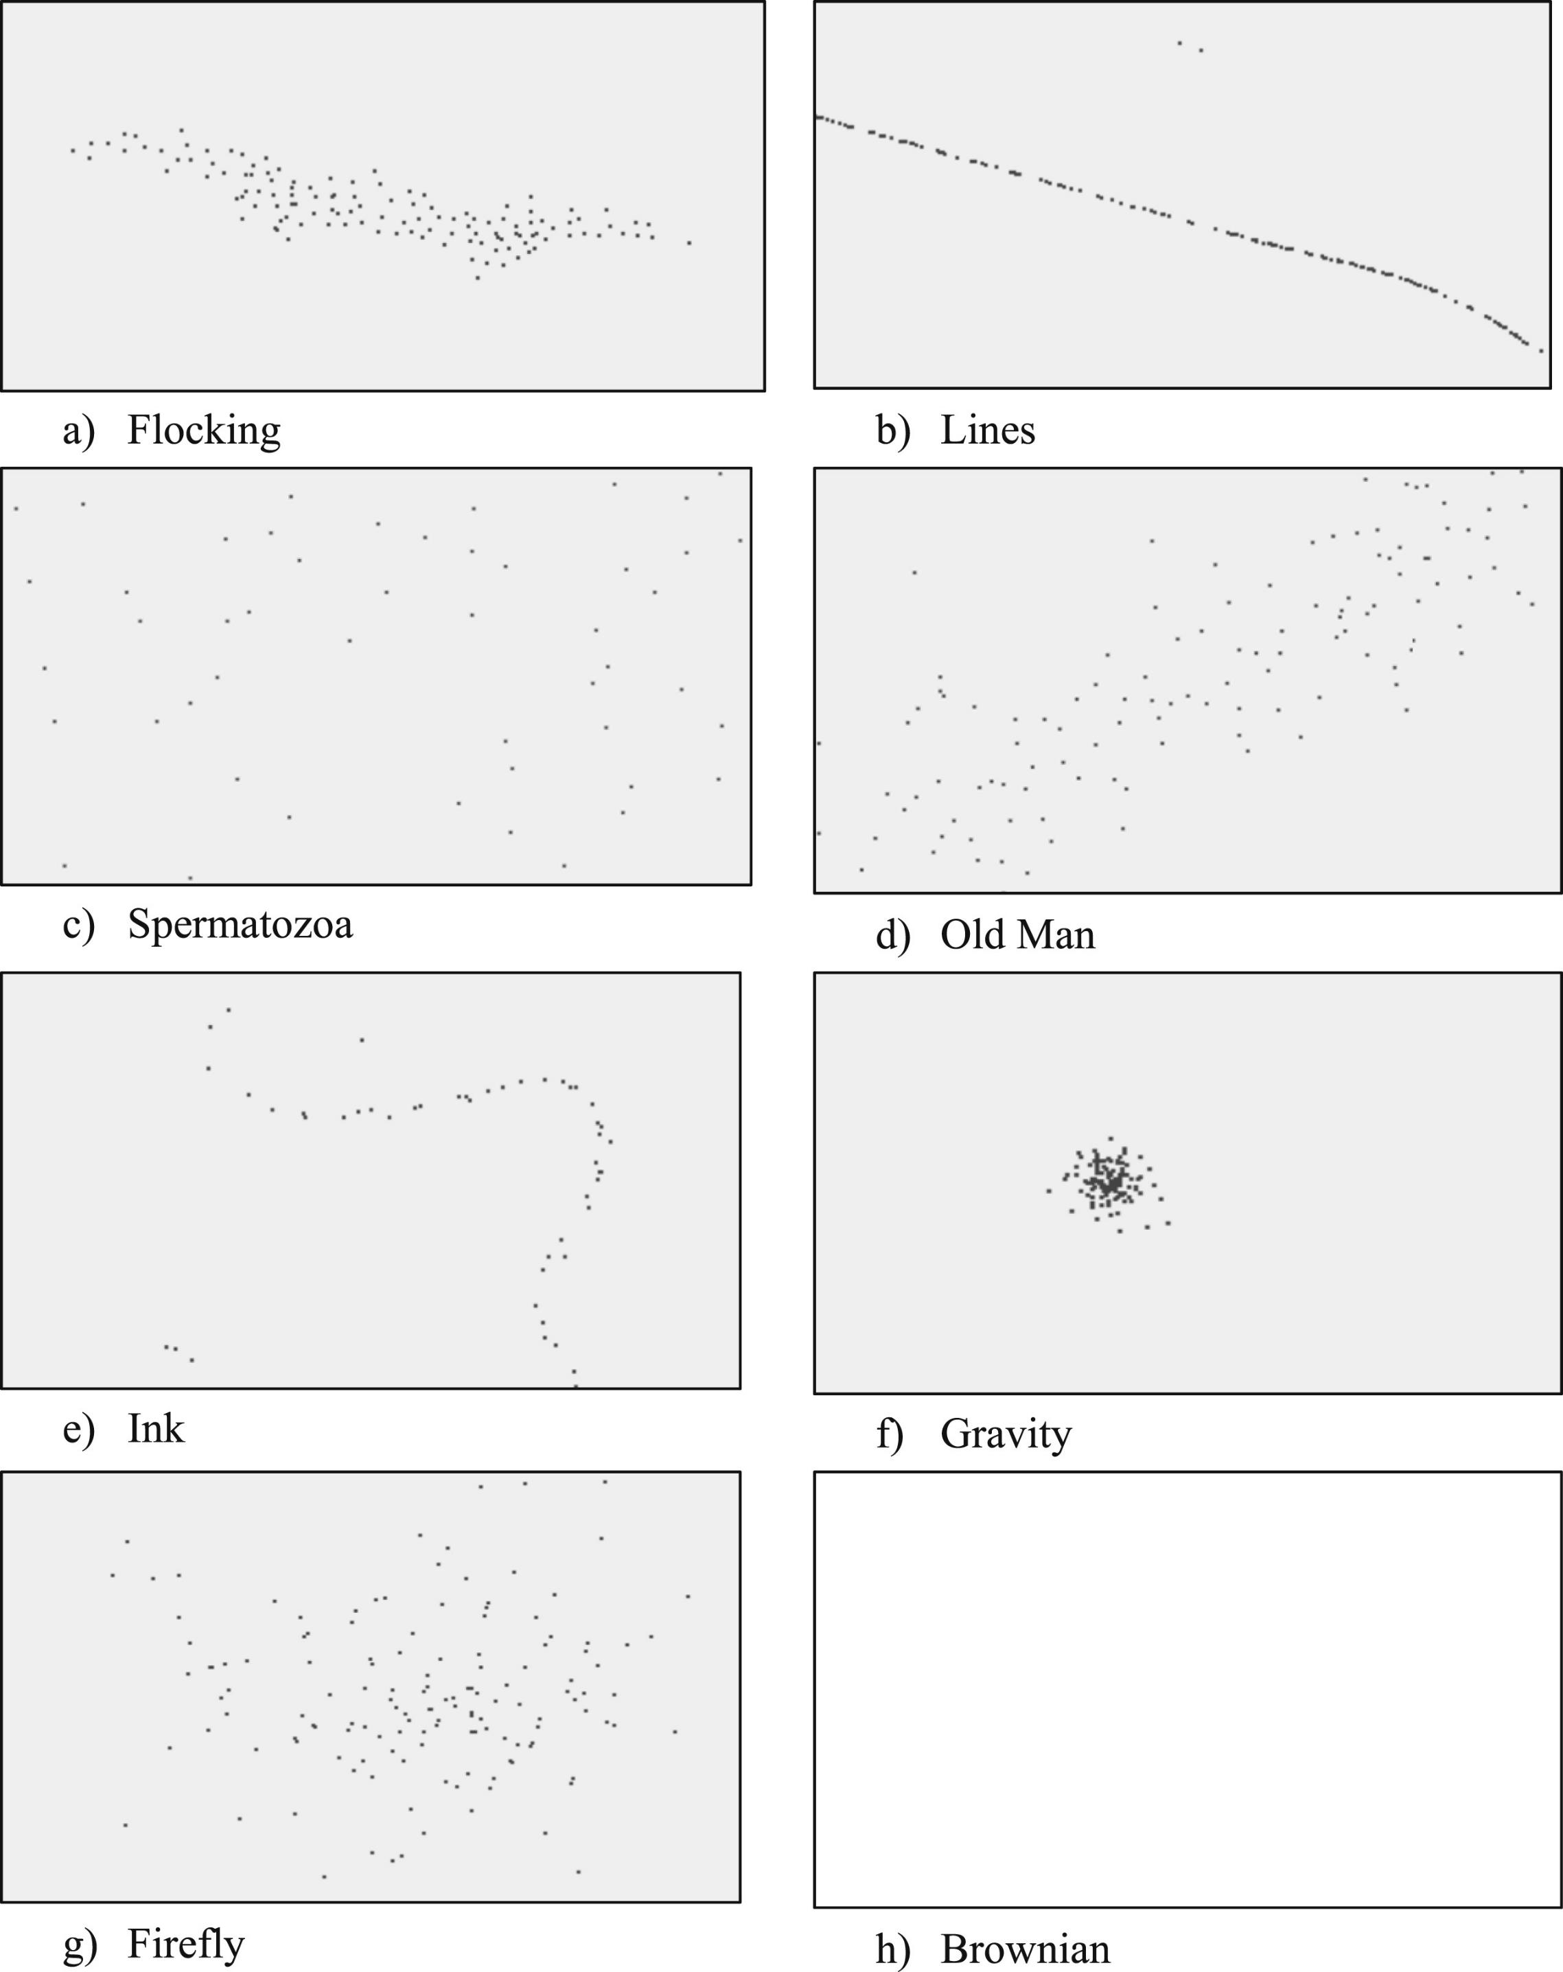
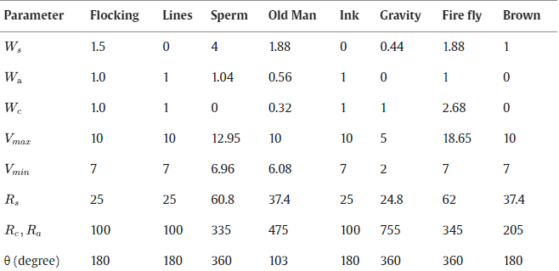
Emergent Behaviour
Exists in nature through evolutionary drive (e.g. : birds flocking, ants in a line)
Modifying Boid parameters to recreate this within artificial swarms
Notes:
Emergent collective motion and emergent formations have been shown by Khan et al. and Abpeikar et al. through modification to the Boid parameters
This can be seen within the slide, as the parameters match up to the different simulated emergent behaviour
The goal of this research project is to utilise this work and to modify and implement this within the heterogeneous swarm
This is made possible by provision of swarming code for both BOLT and RVR

Slide 7
Current Progress
RVR and BOLT Communications
Simulations with size and agility heterogeneity
Heterogeneous Boid Swarming with Vicon Code
Notes:
Talk about the idea:
Get the comms working
Get the sims to figure out the problems
Write the code

Slide 8
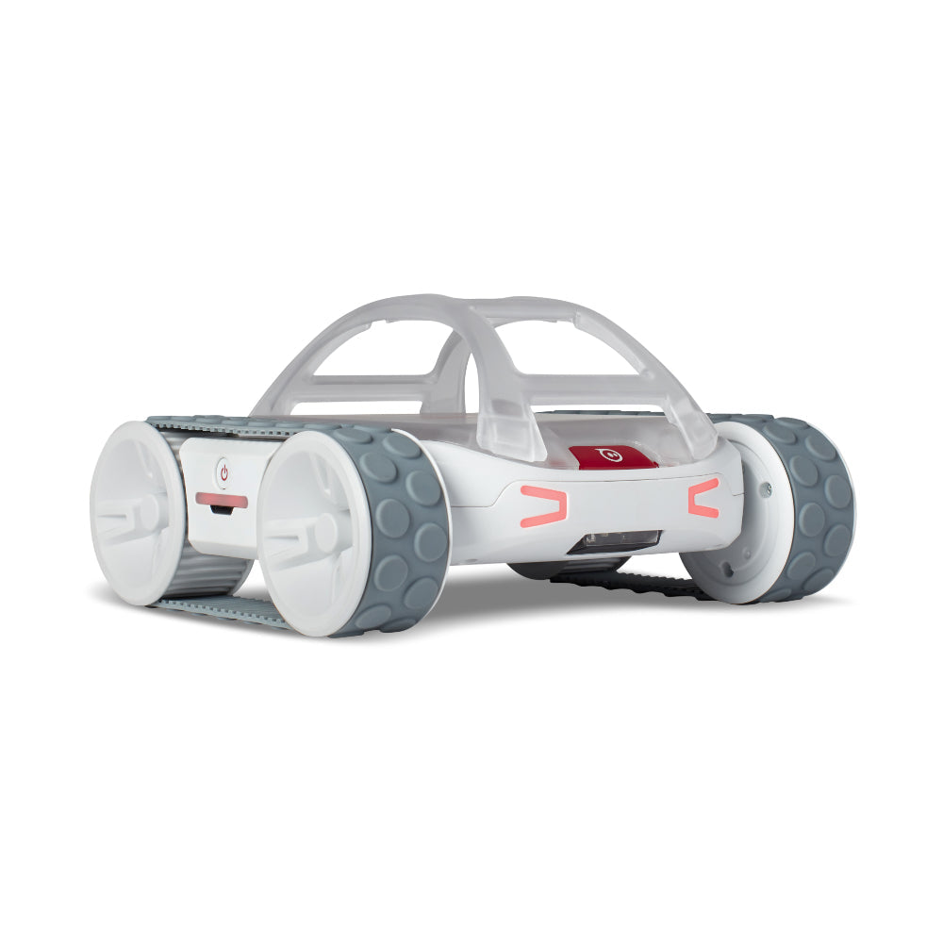
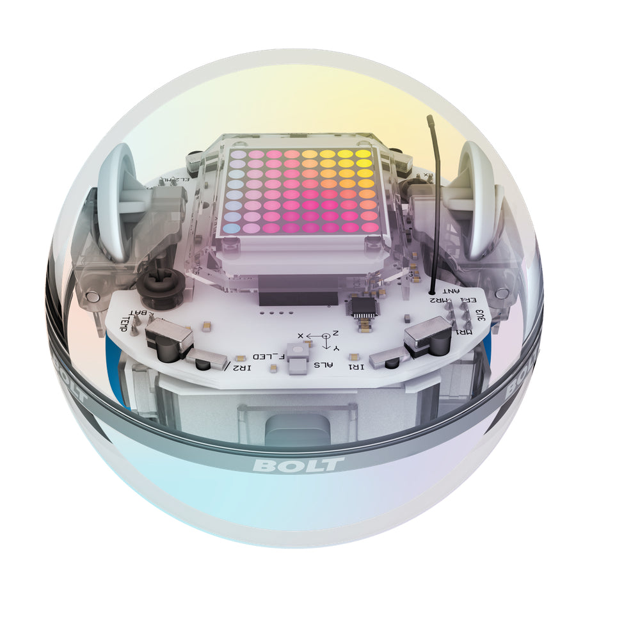
RVR and BOLT Similarities
Accelerometer
Gyroscope
Magnetometer
Light Sensor
Encoders

Slide 9
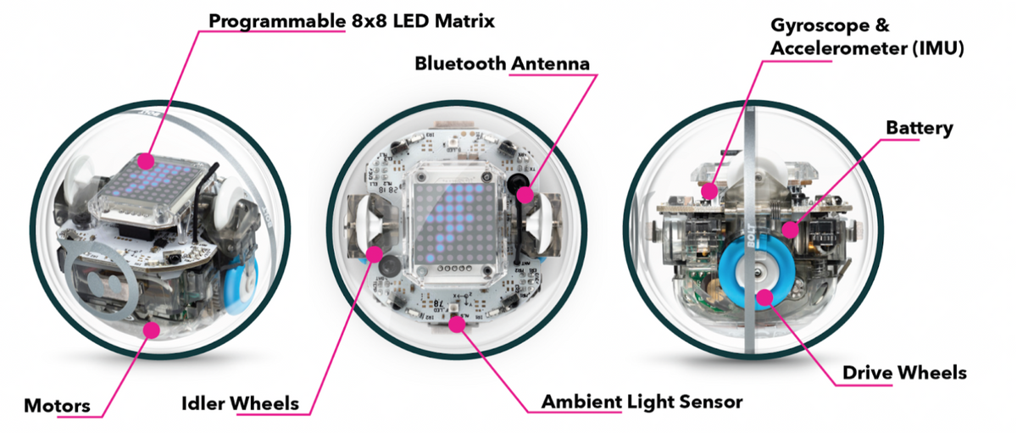
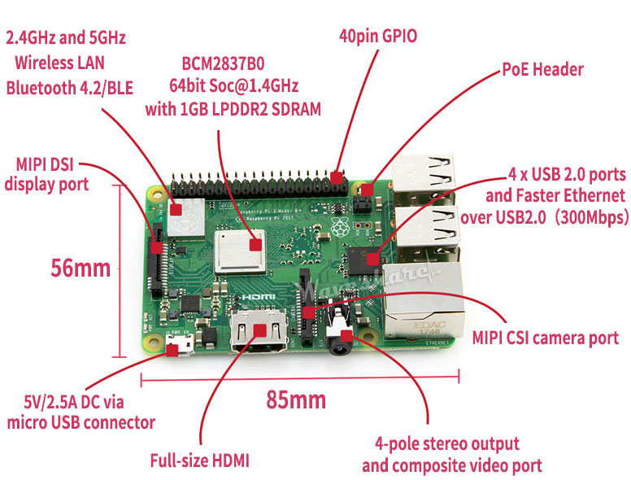
RVR and BOLT Differences
RVR - Raspberry Pi 3B via UART
GPIO Expansion Pins
Bluetooth 4.2
USB 2.0
WiFi
BOLT - Onboard microcontroller
Bluetooth 4+
IR Transceiver

Slide 10
Communications
Infrared
Bluetooth
Line of Sight
Can transmit distance and data
Existing implementation of BOLT IR following of RVR
Python implementation cannot adjust following or send complex custom messages
RF communication
BOLT given commands through spheroV2 API via Python
Processing can be performed on Raspberry Pi 3B+

Slide 11
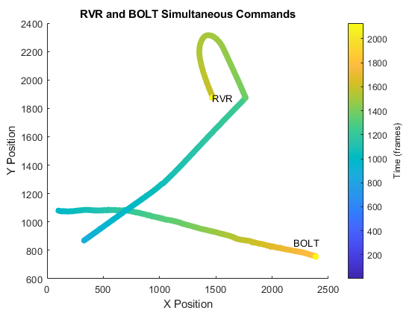
Communications - Proof of Concept
Built off existing RVR code
Code ran:
RVR moving and turning sporadically
BOLT moving in straight line while slowly updating its heading

Slide 12
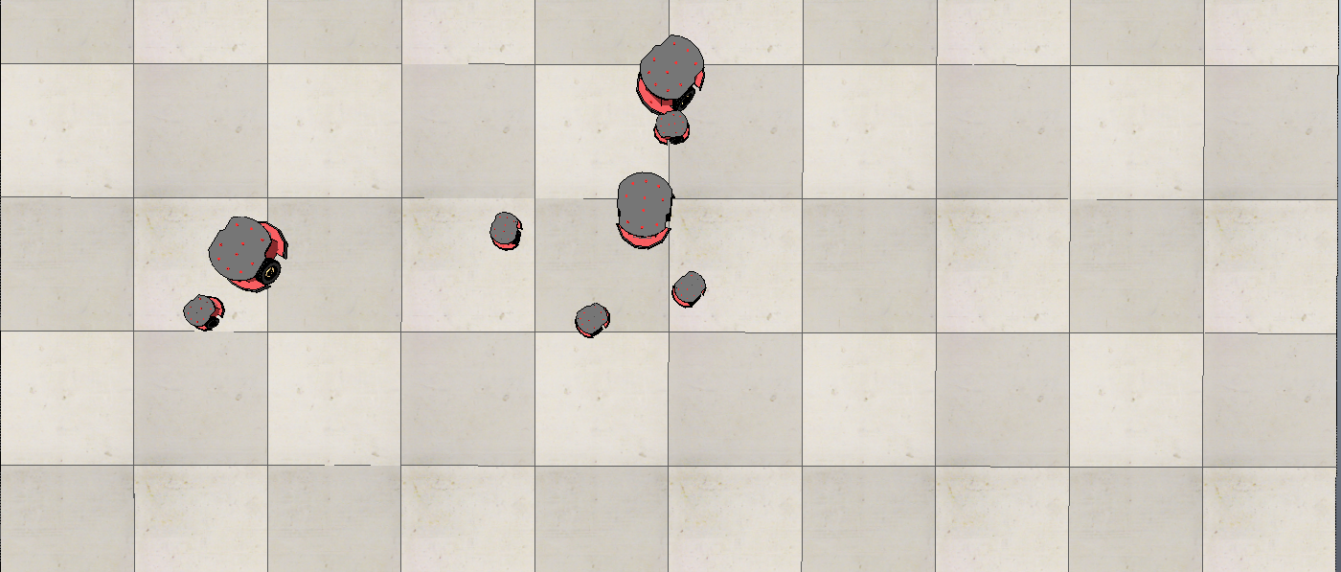
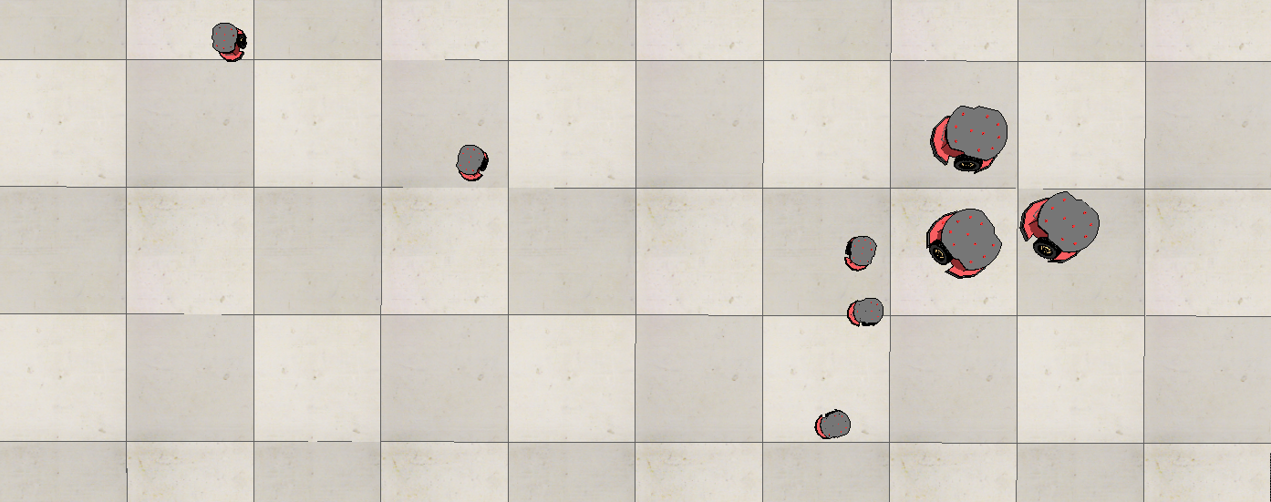
Simulations
Unexpected Collisions
Swarm Divergence
Notes:
During the simulation, after agents had initially formed swarms, two key issues were noticed, collisions and divergence
This is most likely due to the lack of scaling of swarm velocity as well as the lack of different boid rule radii
The simulations proved useful in uncovering possible challenges that may come about in the development and implementation of the full code
hence faster robots and slower robots need to have adjusted boid parameters or artificial linear and angular velocity limits

Slide 13
Current Code
Vicon Bridge
Python Vicon DataStream SDK is Windows only, no existing ARM compiled version
Vicon bridge transmits vicon data from Windows via pylsl to Raspberry Pi
Modified to transmit robot identifiers and BOLT location data to Raspberry Pi
Vicon Locator
Pulls pylsl stream from Vicon Bridge run on laptop and passes data to RVR and BOLT Agent objects

Slide 14
Current Code
Agents
Boid agent object with knowledge of its own and its neighbours’ position and velocity
1st iteration utilised RVR and BOLT specific methods
Conflicts with RVR asyncio library
2nd iteration utilises RVRAgent and BOLTAgent specific objects
RVR Controller
Initialise the Vicon Connection, RVR and BOLTs,
Pass location data locally on the Raspberry Pi
Transmit local data over TDP LAN to other Raspberry Pi’s
Notes:
The conceptual design of the code is to initialise each robot as a Boid agent under its own thread
To enable parallel computing
To enable raspberry Pi to host multiple BOLTs as well as its own RVR
To enable raspberry Pi to transmit its BOLT and RVR data to other Raspberry Pi
1st iteration –
RVR and BOLTs were ran through specific methods under the Agent class
This caused issue with RVR control system that utilised an asyncio control loop while the BOLT spheroV2 library did not use this
2nd iteration –
RVR and BOLT specific classes,
This has shown specific advantages in controlling the RVR and BOLT, resolving runtime issues and increasing modularity of the system
Vicon data is now handled outside of the Agent class in its own ViconLocator.py class.
The disadvantage of this is now objects must pass data between each other, which presents a software development and compute power challenge
Currently the data is passed through each object on the Raspberry Pi through a .json file - > faster then a csv file while maintaining python dictionaries of locations

Slide 15
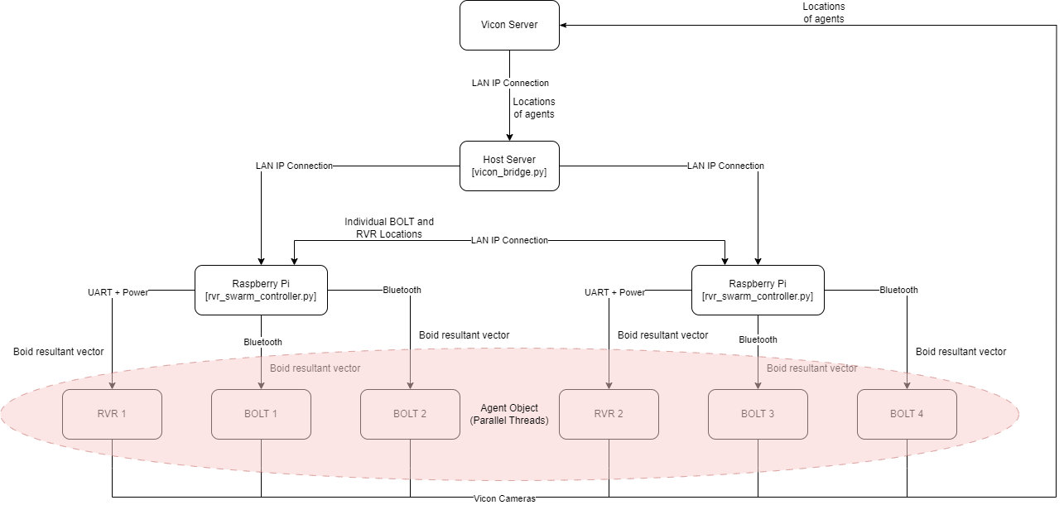
Notes:
This diagram shows both the communications scheme as well as the architecture of the entire system
This is the earlier version

Slide 16
Future Work
Gantt chart here

Slide 17
Future Work
Points on future work

Slide 18
Conclusion

